Slide 1
Human Computer Interaction.
Balage Silva B.P.P.Silva
10707375 18409
1

Slide 2
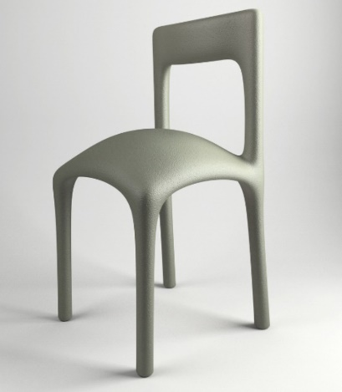
Chair
This is a chair. Unable to sit in this chair. The chair on which to sit this chair is protruding from the wooden part so you can’t sit there. So this is a bad product in the world.
2

Slide 3
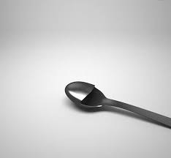
Spoon
This is a Spoon. This spoon cannot be used. Half of its curved part protrudes backwards, so it is difficult to get what we want to eat and drink with this spoon. So this is a bad product in the world.
3

Slide 4
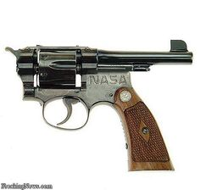
Gun
This is a gun. This gun cannot be used because its barrel part is turned backwards and the butt part is turned so that it is wrong to have the bullet coming to its side when shooting. So this is a bad product in the world.
4

Slide 5
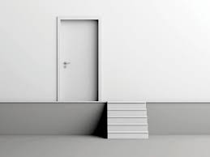
Door and Stairs
This is a door and stairs. The stairs and the door are in two places. This is not connected together. The door should have a staircase below the door. In this case it is wrong to have the stairs a little further away from the door. So this is a bad product in the world.
5

Slide 6
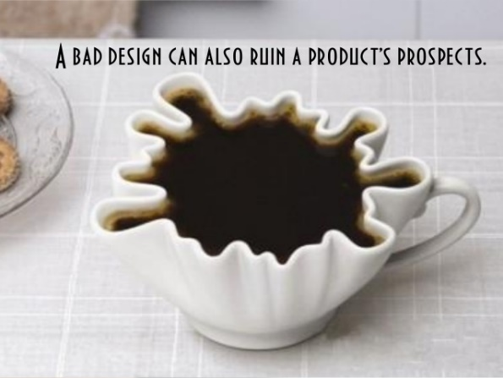
Tea Cup
This is a tea cup. Here the upper part of this cup of tea is indirectly absent from the drinking part. It is difficult to drink because it takes different forms. Drinking is likely to be choked. It is hard to have a mouth, this is a useless product. So this is a bad product in the world.
6

Slide 7
THANK YOU!
7

